Slide 1
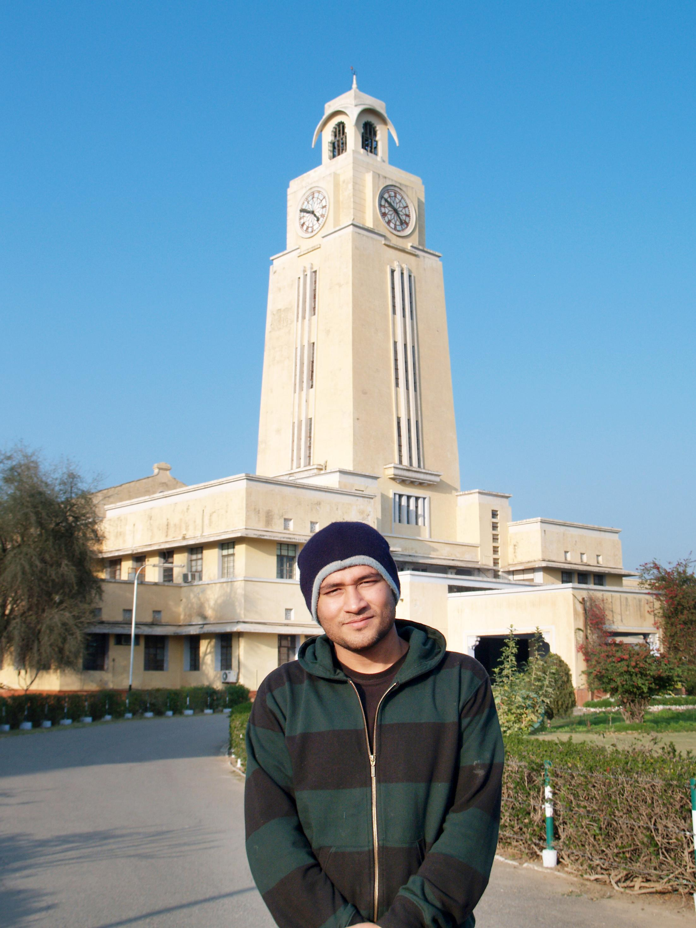

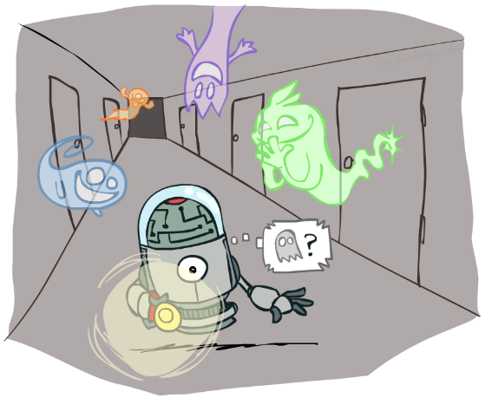

BITS Pilani
Pilani Campus
DSE CL 557 - Artificial and Computational Intelligence
Reasoning over time – Hidden Markov Model
The slides are adapted from various online resources
Monday, January 11, 2021

Slide 2
Today
Reasoning over time
Time and Uncertainty
Inference in temporal models
Overview of HMM
(some slides adapted from Stuart http://aima.cs.berkeley.edu/)
Reference: Chapter 15.1 to 15.3 from AI: A modern approach (Russell, Norvig)

Slide 3
Probabilistic reasoning over time
... means to keep track of the current state of
a process (temperature controller, other controllers)
an agent with respect to the world (localisation of a robot in some “world”)
in order to make predictions or to simply understand what might have caused this current state.

Slide 4
Probabilistic reasoning over time
This involves both
a transition model (how the state is assumed to change)
a sensor model (how observations / percepts are related to the world state).
Previously:
the focus was on what was possible to happen (e.g., search), now it is on what is likely / unlikely to happen
the focus was on static worlds (Bayesian networks), now we look at dynamic processes where everything (state AND observations) depend on time.

Slide 5
Reasoning over time
With
Xt the current state description at time t
Et the evidence obtained at time t
we can describe a state transition model and a sensor model that we can use to model a time step sequence - a chain of states and sensor readings according to discrete time steps - so that we can understand the ongoing process.

Slide 6
Reasoning over time
We assume to start out in X0, but evidence will only arrive after the first state transition is made: E1 is then the first piece of evidence to be plugged into the chain.
The “general” transition model would then specify
ℙ( Xt | X0:t-1)
... this would mean we need full joint distributions over all time steps... or not?

Slide 7
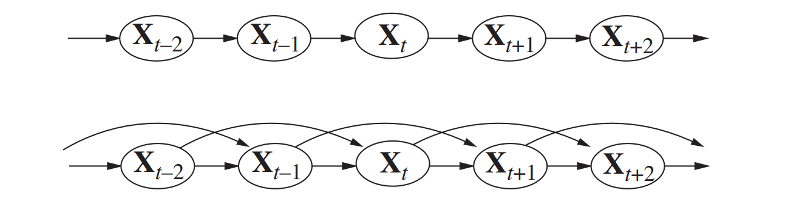
The Markov assumption
A process is Markov (i.e., complies with the Markov assumption), when any given state Xt depends only on a finite and fixed number of previous states.

Slide 8
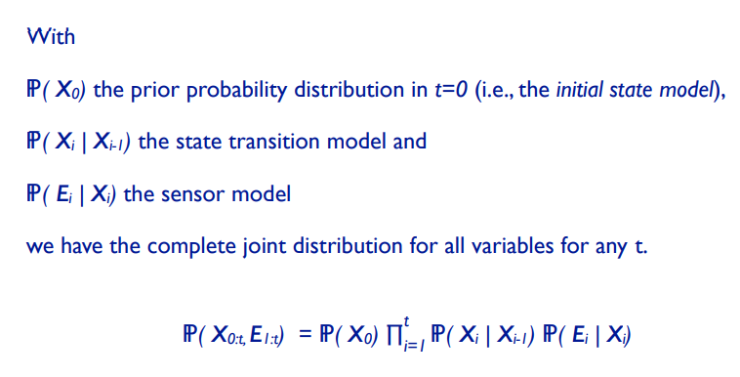
Inference for any t

Slide 9

Reasoning over Time or Space
Often, we want to reason about a sequence of observations
Speech recognition
Robot localization
User attention
Medical monitoring
Need to introduce time (or space) into our models

Slide 10


Markov Models
Value of X at a given time is called the state
Parameters: called transition probabilities or dynamics, specify how the state evolves over time (also, initial state probabilities)
Stationarity assumption: transition probabilities the same at all times
Same as MDP transition model, but no choice of action
A (growable) BN: We can always use generic BN reasoning on it if we truncate the chain at a fixed length
X₁
X₂
X₃
X₄

Slide 11
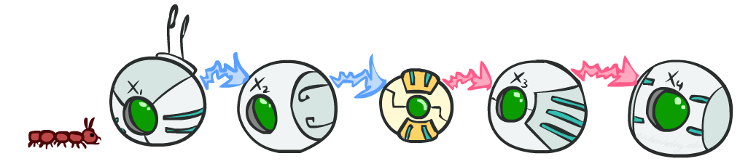
Markov Assumption: Conditional Independence
Basic conditional independence:
Past and future independent given the present
Each time step only depends on the previous
This is called the (first order) Markov property

Slide 12
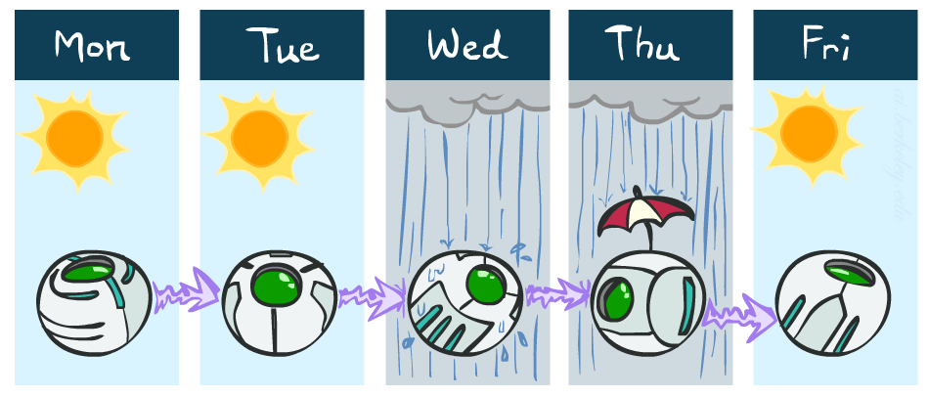
Example Markov Chain: Weather
States: X = {rain, sun}
Initial distribution: 1.0 sun
CPT P(X_{t} | X_{t-1}):
Two new ways of representing the same CPT
X_{t-1} | X_{t} | P(X_{t}|X_{t-1})
sun | sun | 0.9
sun | rain | 0.1
rain | sun | 0.3
rain | rain | 0.7
0.9
0.3
0.9
rain
sun
sun
sun
0.1
0.3
rain
rain
0.7
0.7
0.1

Slide 13
Example Markov Chain: Weather
0.9
0.3
Initial distribution: 1.0 sun
What is the probability distribution after one step?
rain
sun
0.7
0.1

Slide 14
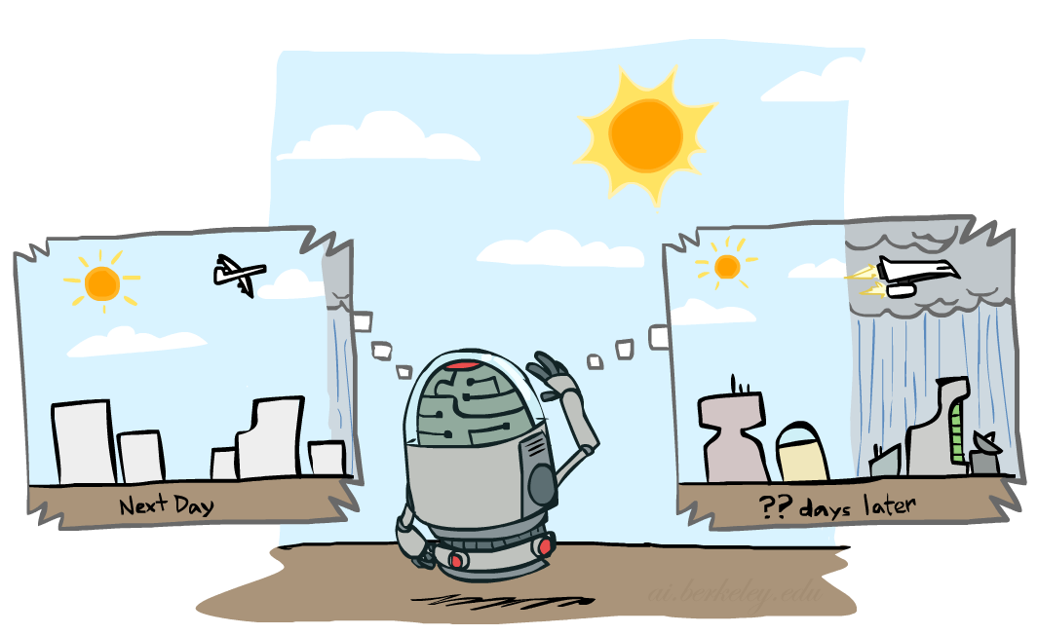

Mini-Forward Algorithm
Question: What’s P(X) on some day t?
X₁
X₂
X₃
X₄
Forward simulation

Slide 15
Why Hidden, Markov Model?
The reason it is called a Hidden Markov Model is because we are constructing an inference model based on the assumptions of a Markov process.
The Markov process assumption is simply that the “future is independent of the past given the present”.
In other words, assuming we know our present state, we do not need any other historical information to predict the future state.

Slide 16
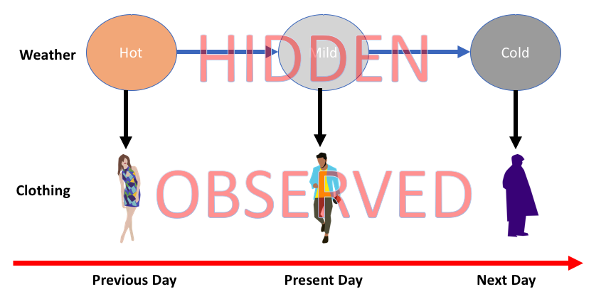
Why Hidden, Markov Model?

Slide 17
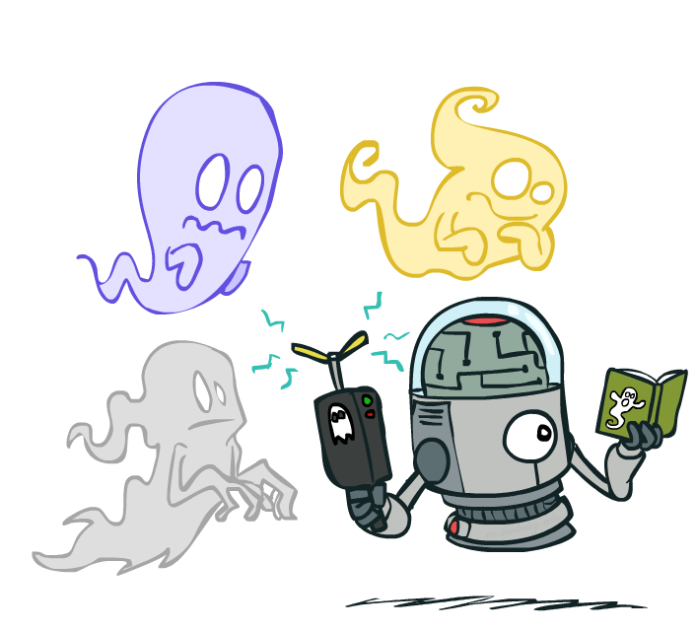
Hidden Markov Models
Markov chains not so useful for most agents
Need observations to update your beliefs
Hidden Markov models (HMMs)
Underlying Markov chain over states X
You observe outputs (effects) at each time step
X₁
X₂
X₃
X₄
X₅
E₁
E₂
E₃
E₄
E₅

Slide 18
Conditional Independence
HMMs have two important independence properties:
Markov hidden process: future depends on past via the present
Current observation independent of all else given current state
Does this mean that evidence variables are guaranteed to be independent?
[No, they tend to correlated by the hidden state]
X₁
X₂
X₃
X₄
X₅
E₁
E₂
E₃
E₄
E₅

Slide 19
HMM

Slide 20
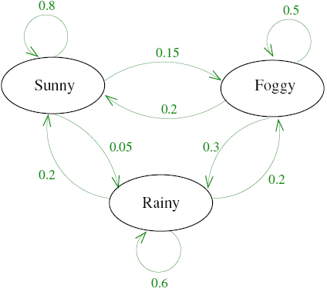
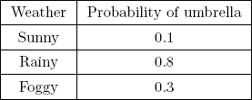

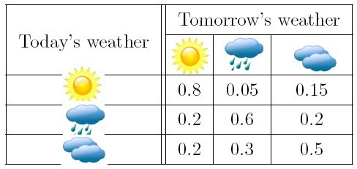
Hidden Markov Models(Example 1)
assume probabilities as seen in the table:
CPT

Slide 21
HMM Example 1 contd.

Slide 22
Q2. Find the Part of Speech tags
obs = ['Bob','ate','the','fruit']
Initial Distributions: {'Verb': 0.05, 'Noun': 0.9, 'Determiner': 0.05}
Transition Probabilities +------------+--------+--------+--------------+ | rows | Verb | Noun | Determiner | |------------+--------+--------+------------------------+--------+--------+--------------| | Verb | 0.1 | 0.8 | 0.1 | | Noun | 0.1 | 0.1 | 0.8 | | Determiner | 0.8 | 0.1 | 0.1 | |------------+--------+--------+------------------------+--------+--------+--------------| Emission Probabilities +--------+--------+--------+--------------+ | rows | Verb | Noun | Determiner | |--------+--------+--------+--------------| | Bob | 0.05 | 0.9 | 0.05 | | fruit | 0.05 | 0.9 | 0.05 | | the | 0.05 | 0.05 | 0.9 | | ate | 0.9 | 0.05 | 0.05 | +--------+--------+--------+--------------+

Slide 24
Problem 3:
Consider an apartment where all residents are either healthy or have a fever and only the doctor can determine whether each has a fever. The doctor diagnoses fever by asking patients how they feel. The residents may only answer that they feel normal, dizzy, or cold. The doctor believes that the health condition of his patients operates as a discrete Markov chain. There are two states, "Healthy" and "Fever", but the doctor cannot observe them directly; they are hidden from him. On each day, there is a certain chance that the patient will tell the doctor he is "normal", "cold", or "dizzy", depending on their health condition. Set of Observations: {Dizzy, cold, Normal}, Set of states={Healthy, fever} If the observation sequence is [cold normal dizzy]. Use Viterbi Algorithm to compute the corresponding state sequence

Slide 26
Real HMM Examples
Robot tracking:
Observations are range readings (continuous)
States are positions on a map (continuous)
Speech recognition HMMs:
Observations are acoustic signals (continuous valued)
States are specific positions in specific words (so, tens of thousands)
Machine translation HMMs:
Observations are words (tens of thousands)
States are translation options

Slide 27
Thank you for your Attention
Any more queries

